Slide 1

PERCENTAGES
Using statistical tools in Natural Science. Bilingual 2nd year of ESO.

Slide 2
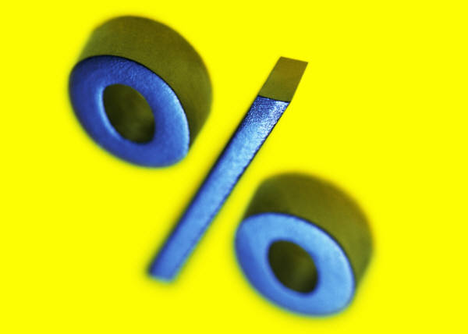
Percentage: meaning
Example: Imagine that in the first year of ESO there are 100 students and that only 19 of them belong to the “Bilingual Project”.
How much is the percentage of first’s year students that study in English?
Yes, it is 19 %.
A percentage, %, read ‘per cent’, means ‘out of hundred’.
% is a short way of writing ‘per cent’.
  Example: 20% means twenty per cent, which is 20 out of 100 (There are 20 units of a particular kind in 100 units of things).
Vocabulary: porcentaje, sobre 100, tanto por ciento.

Slide 3
Working out percentages (I)
In the table below, how many squares are there?
How many of them are yellow?
How is the percentage of yellow squares in the table?
In the table below, which is the percentage of red squares?
Solution:
The table has 100 squares. Only 23 of them are yellow. So the yellow squares are 23% of the total.
Solution:
The table has 100 squares. Only 50 of them are red; so, the percentage is 50%, or one half.

Slide 4
%, fractions and decimals
A percentage is a fraction of 100.
  Ex: 20 % is the same as 20 /100
  20 % = 20/100
We can convert percentages into decimals:
  20 % = 20/100 = 0.20
  45 % = 45 /100 = 0.45
= 0.2
= 0.45

Slide 5
% of a quantity
When we say that % means “out of hundred”, the word ‘of’ in the expression means ‘times’.
So, to obtain the percentage of a quantity, we have to multiply.
To find 15% of 60, we have to do:
  (15/100)x60 = 0.15 x 60 = 9
Table of 10x6 = 60
Language remark:
“4 % of something”
  you have to write and read it without the article “the”.

Slide 6
Working out percentages (II)
In the table below, how many squares are yellow ?
How is the percentage of yellow squares in the table?
In the table below, which is the percentage of red squares?
Which fraction of squares are red?
Solution:
The table has 64 squares. Only 16 of them are yellow. So, the yellow squares are (16/64) x 100 = 25% of the total=0.25
Solution:
The table has 80 squares. Only 48 of them are red; so, the percentage is: (48/80) x 100 = 60% = 60/100 = 0.60

Slide 7
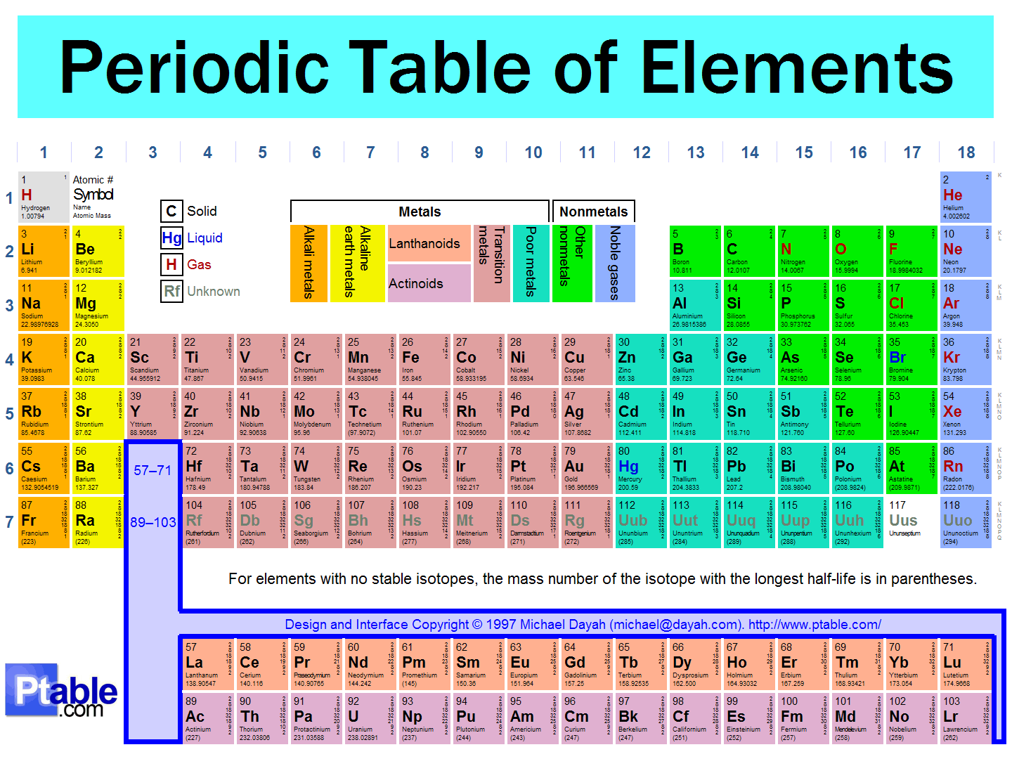
A chemical example:
Periodic table of elements
This table contains all the elements that scientists have found in the Universe until now. How many of them are there?
http://www.ptable.com/?lang=en

Slide 8

For your notebook
This year you have to learn only the name and the symbol of the following elements:
1 | 2 | 3 | 4 | 5 | 6 | 7 | 8 | 9 | 10 | 11 | 12 | 13 | 14 | 15 | 16 | 17 | 18
H |  |  |  |  |  |  |  |  |  |  |  |  |  |  |  |  | He
Li | Be |  |  |  |  |  |  |  |  |  |  | B | C | N | O | F | Ne
Na | Mg |  |  |  |  |  |  |  |  |  |  | Al | Si | P | S | Cl | Ar
K | Ca |  |  |  | Cr | Mn | Fe | Co | Ni | Cu | Zn |  |  |  |  | Br | Kr
Rb | Sr |  |  |  |  |  |  |  |  | Ag |  |  | Sn |  |  | I | Xe
Cs | Ba |  |  |  | W |  |  |  |  | Au | Hg |  | Pb |  |  |  | Rn
Fr | Ra |  |  |  | U |  | Pu
What is the percentage of elements you have to learn this year?

Slide 9
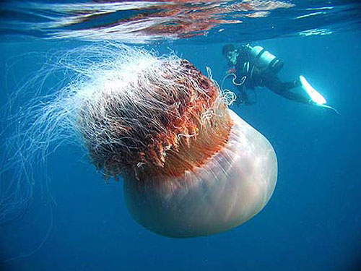
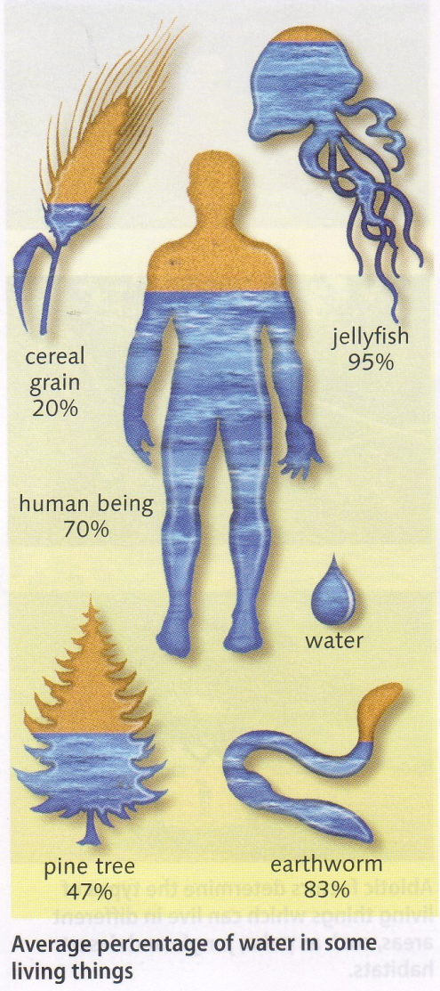
Other example: Water in living things
All living things need water to live, because they are made of a high percentage of water.
Imagine that your 20 classmates have an average weight of 45 kg. How many kg of water do all their bodies contain?
The giant Japanese Nomura jellyfish weights 200 kg. According to the data, how many grams of water does one of these jellyfish contain?

Slide 10
From fractions to %
We can convert fractions into percentages:
Example:
  39/130 = 0.3
  0.3 x 100 = 30%
For your notebook:
The muscles of a man of 80 kg weigh 36 kg. Which is the percentage of his mass that corresponds to muscles?
The mass of a certain woman is 60 kg. Their bones weigh 7.2 kg. Which is the percentage of her mass that corresponds to bones?

Slide 11

From % to diagrams
We can convert percentages into diagrams.
For this year, the most useful of them is the sector diagram, usually called “pie chart” because of its appearance.
We are going to study it later.
Vocabulary: diagrama de sectores o diagrama de tarta.

Slide 12

Percentages
References:
Free material from the Internet.
CGSE books.
These materials have been adapted for the 2nd year of ESO by
  Mª del Carmen Urlanga Zubillaga
  Departamento de Física y Química
  IES José Mª Pereda, Santander.

