Slide 1

PIE CHARTS
Using statistical tools in Natural Science. Bilingual 2nd year of ESO.

Slide 2

From % to diagrams
We can convert percentages into diagrams.
For this year, the most useful of them is the sector diagram, usually called “pie chart” because of its appearance.
Vocabulary: diagrama de sectores o diagrama circular o diagrama de tarta.

Slide 3
Pie charts
A : ½ = (1x100/2) = 50%
B: ¼ = (1x100/4) = 25%
C: 1/3 = (1x100)3 = 33.3 %
A pie chart has some coloured sectors.
Each sector represents a fraction of the whole quantity.
Examples: Here we have some easy-to-interpret fractions:
A
B
C

Slide 4


From pie charts to %
Observe the sectors drawn on the classroom blackboard:
-How many sectors do the pie chart have? Are they equal one another?
-Which total percentage do the whole light blue sectors on the half left represent?
-More difficult: And the only dark blue sector in the right?

Slide 5
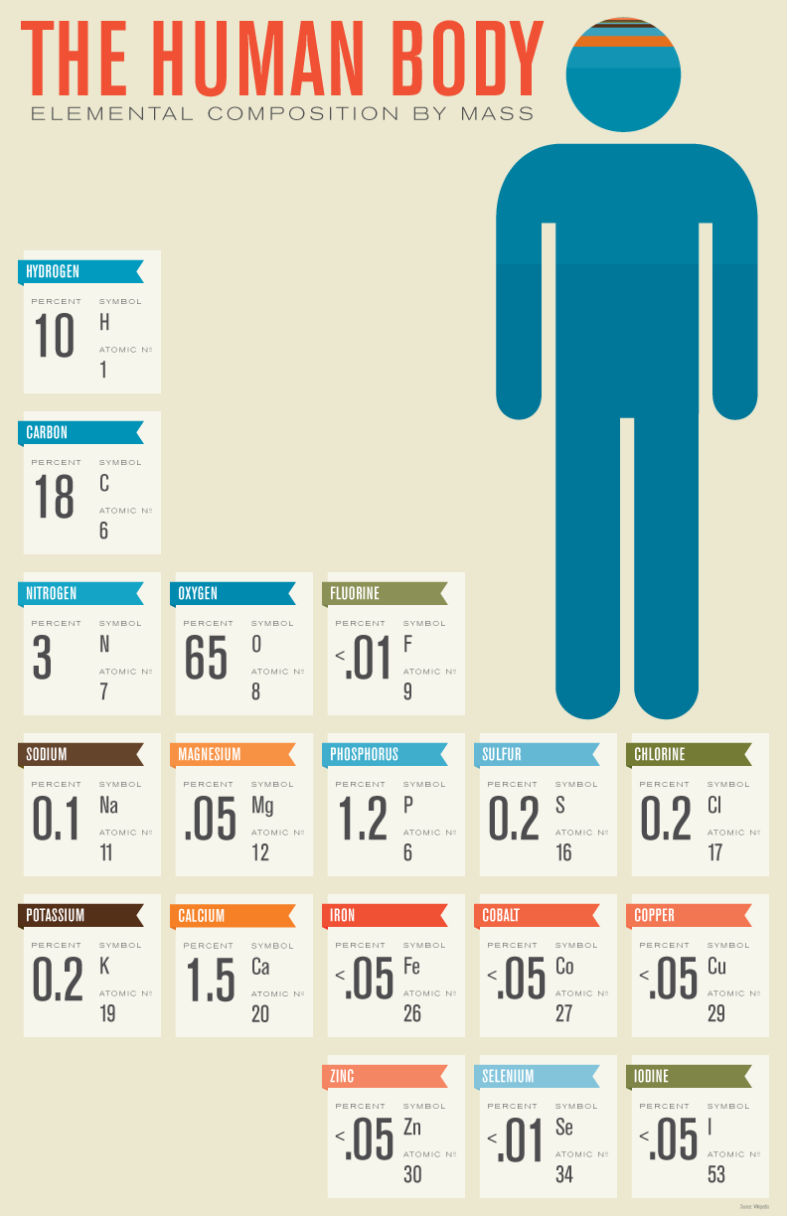
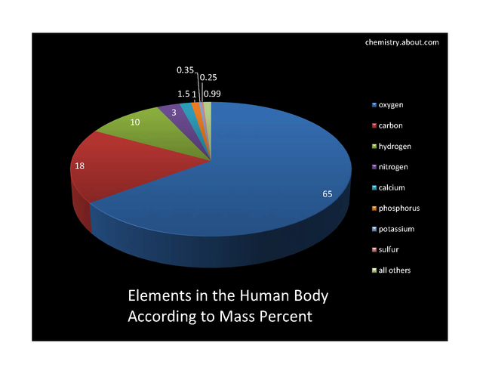
An example: What are we made of?
From % to pie chart (I)
These numbers can be converted into a pie chart.

Slide 6
From % to pie chart (II)
If we have some data expressed in %, we can obtain a pie chart from them.
As the pie chart is circular, we have to transform % or “fractions” into “sectors”.
A sector is a part of a circle.
It is a kind of triangle with two straight sides and another one curved.
The most important magnitude of a sector is the central angle.
This angle can be measured by a protractor.

Slide 7
From % to pie chart (III)
To draw a pie chart, we have to establish a relationship between “grades” and “fractions”.
A circumference contains 360º.
  Half a circumference is:
  360º x(1/2) =180º.
  A quarter of circumference is:
  360º x (1/4) = 90º.
Each fraction corresponds to a certain % and to a certain amount of grades.
  1 = 100% is 360º.
  ½ = 50% is 180º
  ¼ = 25% is 90º,
etc.
So, the formula we have to use is:
“grades” = 360º x “fraction” =
= 360º x (%) /100

Slide 8

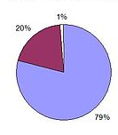
The air we breath
The air is mainly composed by 79% of nitrogen, 20% of oxygen and 1 % of other gases.
This 1% includes carbon dioxide (0,03%) and small proportions of other gases including argon and water vapour.
Transform these percentages into a pie chart.
Solution:

Slide 9
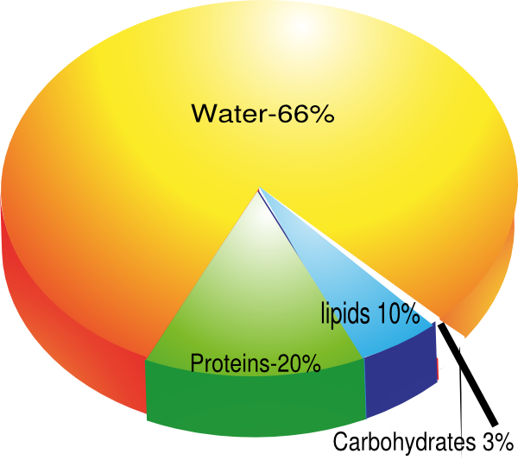
Using pie charts: Average molecular composition of a human body
Transform the quantities in the pie chart into fractions and decimals.

Slide 10
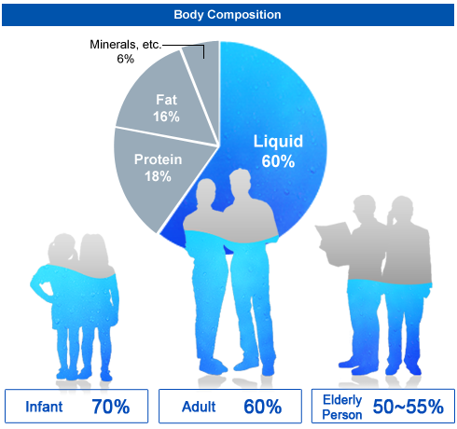
Using pie charts: % of water; variation with age
The pie chart in the picture expresses only average quantities.
But the amount of water varies with age.
What do you thing are the reasons for these changes?

Slide 11
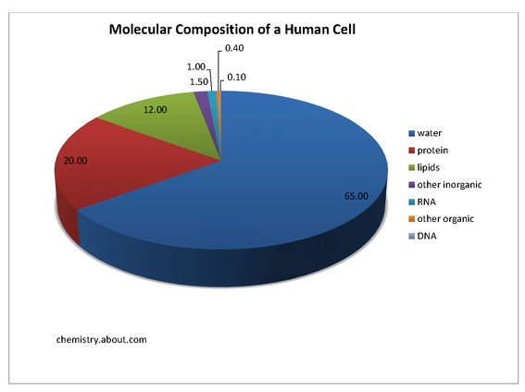
Using pie charts:
Human cells
What is the relationship between the amounts of lipids and proteins?
And between the RNA and the DNA?

Slide 12
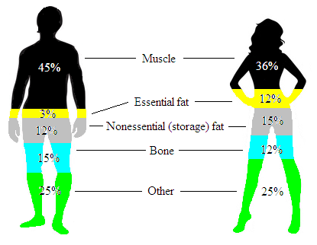
Using pie charts: Men an women mass
What is the relationship between the percentages of stored fat in men and women?
More difficult: Transform the information in the picture into two pie charts.

Slide 13
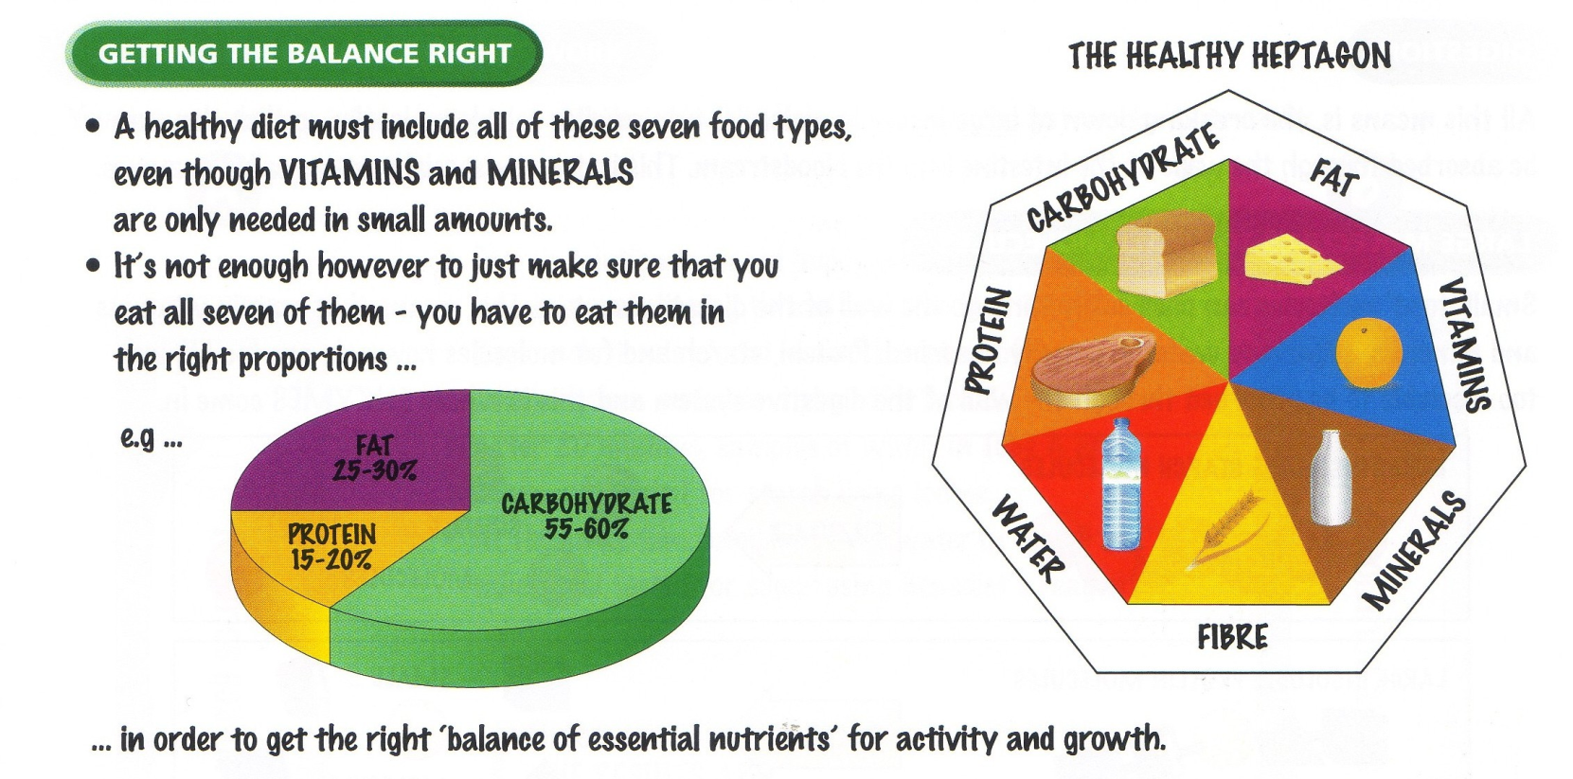
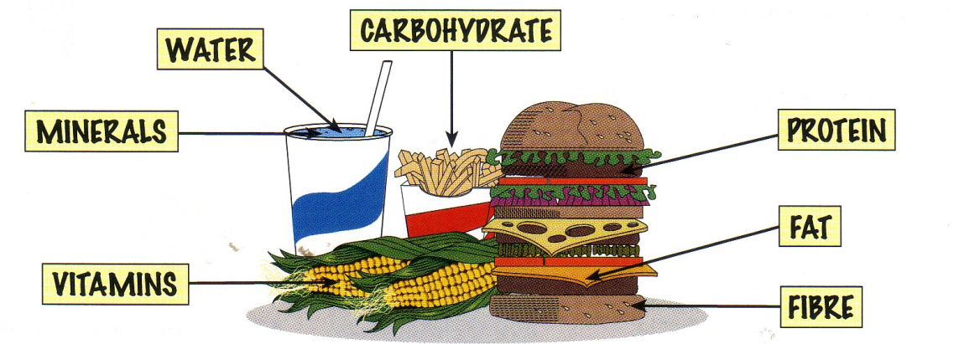
Using pie charts: A healthy diet
Do you think that the meal in the picture represents a healthy diet?
Why? Why not?

Slide 14
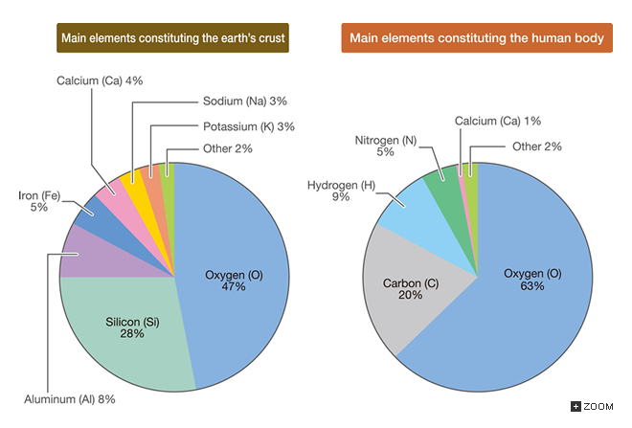
Using pie charts: A comparison between the composition of a human body and the Earth crust
To be developed in the 3rd year of ESO

Slide 15

Pie charts
References:
Free material from the Internet.
CGSE books.
These materials have been adapted for the 2nd year of ESO by
  Mª del Carmen Urlanga Zubillaga
  Departamento de Física y Química
  IES José Mª Pereda, Santander.

